Slide 1
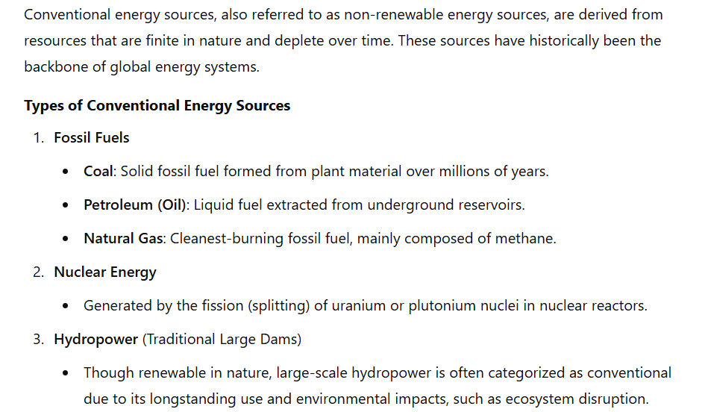
Overview of conventional energy sources

Slide 2
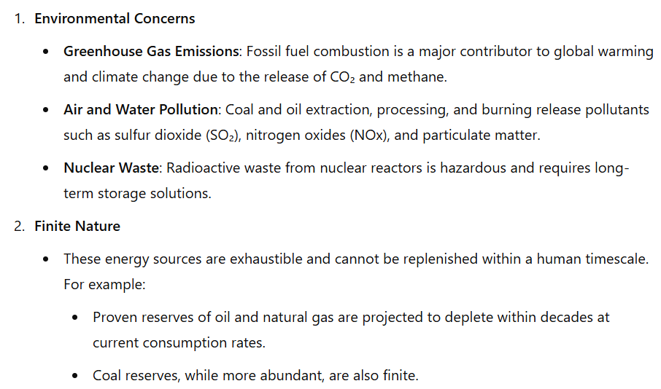
Limitations of Conventional Energy Sources

Slide 3
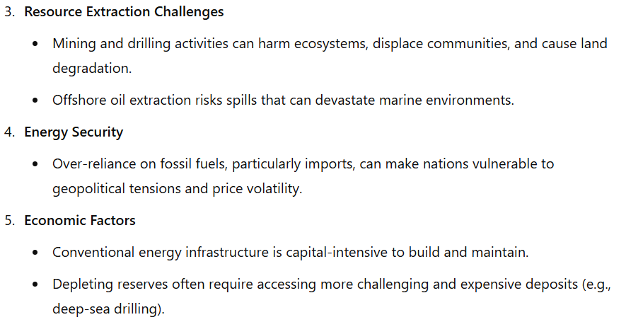
Limitations of Conventional Energy Sources

Slide 4
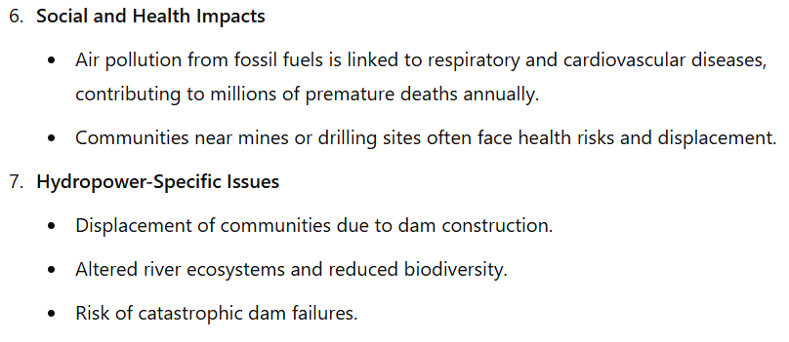
Limitations of Conventional Energy Sources

